Slide 1
SCRUM
Unit 6

Slide 2
Contents
Various terminologies used in Scrum (Sprint, product backlog, sprint backlog, sprint review, retro perspective),
various roles (Roles in Scrum),
Best practices of Scrum (https://www.developer.com/project-management/scrum-best-practices/)

Slide 3
What is Scrum?
Scrum is an agile framework for developing software applications.
Scrum has been in use since the early 1990s. It is a flexible and holistic approach to project management.
Scrum focuses on continuous improvement, learning, and adjusting to the changing market, user requirements, and technology.
Scrum involves a set of events, tools, and roles that work together to help teams structure and manage a project.
Within software development, requirements, market, technology, and other external factors change quite often.
Scrum embraces the changes as the product is built in a series of iterations called sprints.

Slide 4
What is Scrum?
Big projects are broken into smaller pieces that are delivered in several sprints, making the project easier to manage.
Every sprint is released to users, and feedback is collected. Speed to market is also increased.
Scrum is all about continuous learning and adapting to changes.
a scrum team is a small team made of highly adaptive and flexible individuals.

Slide 5
Scrum
Scrum is an empirical process, where decisions are based on observation, experience and experimentation.
Scrum has three pillars: transparency, inspection and adaptation.
there are accountabilities, events and artifacts that make up the Scrum Framework

Slide 6
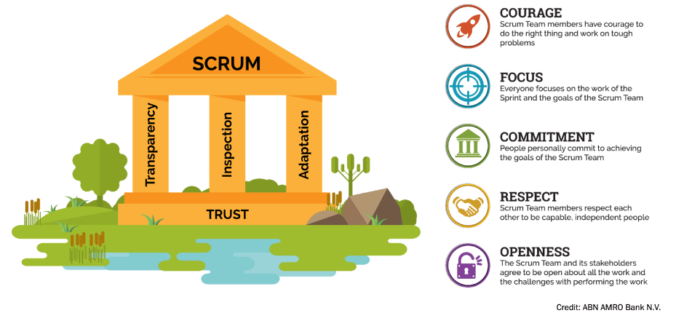
Scrum

Slide 7
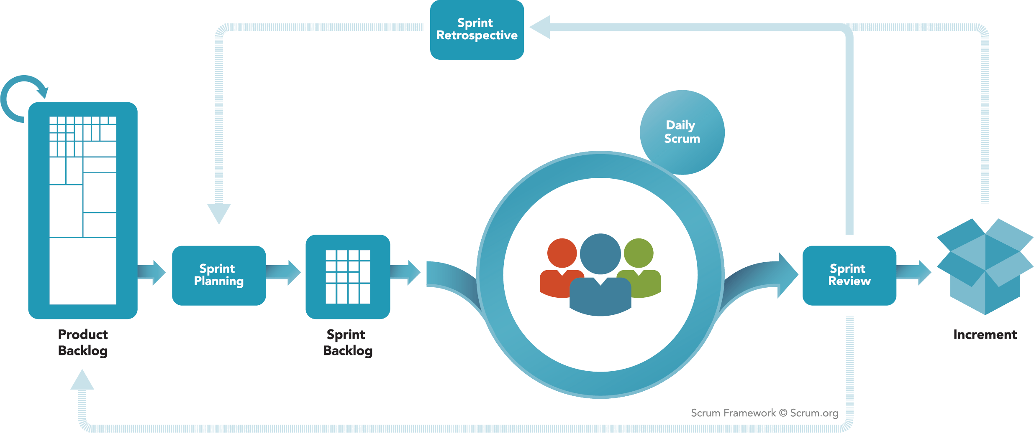
Scrum

Slide 8
Scrum events
Each event is time-bound to a maximum duration.
Strict scrum events reduces the need of meetings that are not defined in the scrum framework.
The events are created to foster transparency and inspection within the scrum team.
Sprint
Sprint planning
Daily Scrum
Sprint review
Sprint Retrospective

Slide 9
Scrum events: Sprint
The sprint is the backbone of scrum. A sprint takes 1 to 4 weeks.
During this period, a potentially shippable product increment is created.
A list of product backlog items, selected during sprint planning, are worked on during each sprint.
A new sprint starts immediately after the end of the previous one.
If a sprint took more than a month, the definition or market of what is being developed might change, increasing complexity and risk.
Each successful sprint constitutes an increment in the final product.

Slide 10
Scrum events: Sprint Planning
The scrum team discuss the items to be worked on during the sprint and creates a sprint goal.
Top priority product backlog items to be worked on during the sprint are selected.
The primary purpose of Sprint Planning is to address “What can be done during the next sprint?” and “How to do the work required to provide the increment?”
Sprint planning takes at most eight hours for a four weeks Sprint.

Slide 11
Scrum events: Daily scrum
It is a fifteen-minute Stand-up event for the development team held daily.
Preferably, it should be held at the same venue and time.
The team discusses what they have completed in the last 24 hours and plan for the next 24 hours’ work.
A check on the progress towards the sprint goals is also done in the stand-up meeting.

Slide 12
Scrum events: Sprint Review
Sprint Review is held towards the end of the Sprint.
This is an opportunity for the team to showcase the completed work to the product owner and partners.
This review process is meant to encourage collaboration and to get feedback.
It takes at most four hours for a one-month sprint.
The development team discuss what worked out during the sprint, the challenges encountered, and how they were addressed.
They also discuss how they will improve the process in the future.
Sprint review provides important input to the upcoming sprint planning.
The deliverable of a Sprint Review is an updated product backlog items for the coming sprint.

Slide 13
Scrum events: Sprint Retrospective
This event happens before the next sprint planning.
It takes at most three hours for a one-month Sprint. The scrum team discusses the following:
What worked well?
What could be improved?
What will the team commit in the next sprint?
Scrum Team members make actionable commitments. The deliverables of this meeting are improvements to be implemented in the next sprint by the Scrum Team.

Slide 14
Scrum Artifacts
Artifacts are there to ensure and maximize the transparency of information.
Every team member must have the same interpretation of an artifact.
The product backlog consists of a list of features, functions, enhancements, and fixes needed.
It is the only source of requirements for the Scrum Team.
The product owner is responsible for its content, availability, and ordering. Since the requirement never stops changing, so does the product backlog. All the requirements are broken down, with the most prioritized at the top.

Slide 15
Scrum Artifacts
The current sprint backlog items are selected from high priority features in the product backlog. It is the output of the sprint planning event. The sprint backlog is modified throughout the sprint. Burndown charts are used to monitor sprint progress.
Increment
The sum of all product backlog completed and “done” during a sprint is referred to as an increment. Each Scrum Team has a definition of “done.” “Done” means in a usable condition as per the Scrum Team definition.

Slide 16
Scrum

Slide 17
Scrum Roles
The team is cross-functional and self-organizing. The team decides how best to accomplish the work and has all the necessary expertise to do it.
Product Owner
Scrum Master
The Development Team

Slide 18
Scrum Roles
Product Owner:
The product owner plays in the part of a client or stakeholder.
He/She is one person and not a group of people.
He or she is responsible for managing the product backlog by clearly expressing items that need to be addressed.
The product owner ensures that the product backlog items are clear for the development team.

Slide 19
Scrum Roles
Scrum Master:
The scrum master is a “servant leader” responsible for protecting the team and the process. The scrum master helps everyone understands the scrum framework as defined in the scrum guide. Other responsibilities include:
Ensuring a good working bond between the development team and the product owner
Protecting the team from outside interactions and disruptions
Facilitating scrum events
Providing optimal techniques for optimal product backlog management
Removing any obstacle that may affect the development team progress

Slide 20
Scrum Roles
The Development Team:
It is a team with the necessary skills to create a product increment by itself.
That is why it is said to be cross-functional and self-organizing. Members lay multiple roles such as design, business analysis, operations, programming, and testing.
Thus, the team recognizes no title for any of its members. Team members may have some particular competencies and areas of specialization, but they are accountable as one.
The team size can consist from three to nine members.

Slide 21
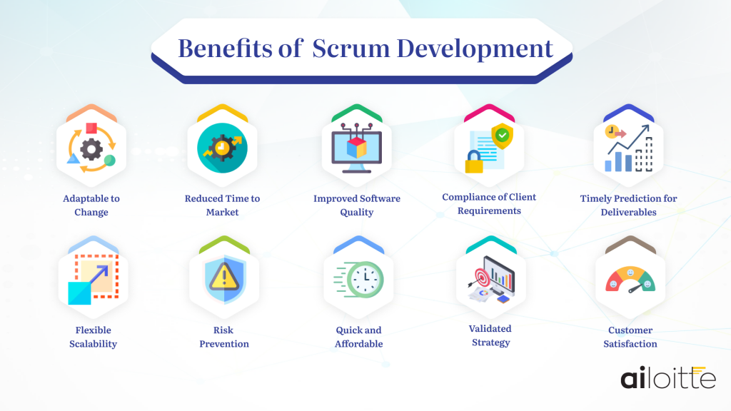
Benefits of Scrum

Slide 22
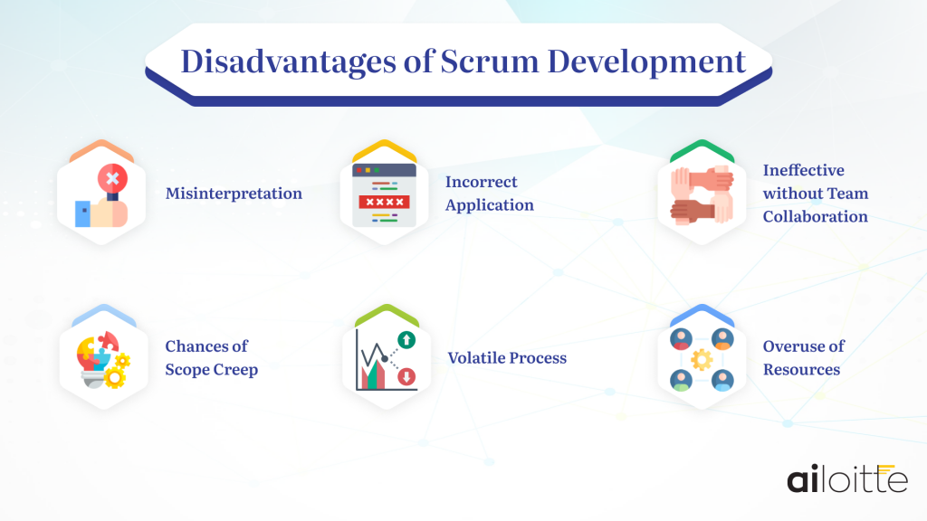
Disadvantages of Scrum

Slide 23
Case study#1
Mayden is a small and successful U.K. company that develops managed Web applications for the health care sector. They specialize in flexible, cloud-based software, delivered by a team of 44 from two locations in England
Mayden has built a track record of delivering value to its customers
The company did have a reputation for being responsive to customer needs, but it tried to execute within a traditional project management environment
CEO Chris May explains the problems that surfaced as a result of trying to be flexible in a Waterfall environment: "Our best-laid plans were continually being hijacked for short-priority developments. The end result was that we reached a point where we had started lots of things but were finishing very little."

Slide 24
Case study
projects were frequently assigned to only one person, so the work "often took months to complete." From a development team standpoint, this approach created individual expertise and worked against a team environment.
People were seen as specialists, and some developers had a large backlog of work while others had insufficient work — but they were unable to assist their colleagues because they didn't have that specialist knowledge.
This created individual silos and led to lack of variety as well as boredom and low morale.
From a company standpoint, it also led to poor skills coverage, with multiple "single points of failure" in the development team.

Slide 25
Case study
Transition:
Reduced lead time for delivery of new features to the customer
Increased skill coverage across the development team, creating a more consistent work flow
More frequent deadlines, keeping the development team alert and focused
Empowered staff who now all contribute and comment on the best way to approach stories
Increased quality of coding due to ongoing assessment from teammates

Slide 26
Case study
Advice:
Even though they were told in training that while Scrum concepts were easy, putting them into practice could be difficult.
If you do choose to implement Scrum, you can't do it halfheartedly; you have to commit to it. Embrace it company-wide and you'll be amazed by the results.
the dynamics of the team may change, which requires an open mind and trust. "The quiet person in the corner who doesn't say much may just well surprise you and become the star of the team, if given the opportunity and environment in which to flourish. We've experienced that firsthand, and Scrum was the catalyst.“
https://resources.scrumalliance.org/Article/case-study-maydens-transformation-waterfall-scrum

Slide 27
Case study#2
How can you build a truck with innovative unique selling propositions in just 18 months, if the regular development cycle is at least five years? MAN Truck & Bus was confronted with this challenge at the end of 2016.
The answer was a cross-functional team and a new way of working for MAN: Scrum. Thanks to the consistent establishment of the agile framework, a 100% dedicated development team including Scrum Master and Product Owner could be set up very quickly.

Slide 28
Case study
When asking the team about the decisive success factors, especially the following points were mentioned: 100% availability of the team members and their co-location, daily coordination with colleagues in the workshop, full support and regular and pragmatic involvement of stakeholders, as well as transparency and communication with related departments.
The most important point, how-ever, is openness and the courage to try something new.
https://www.agile-academy.com/en/organizational-development/case-study-man/

Slide 29
Best Practices of Scrum
Teamwork and collaboration are essential for the scrum framework to work and help agile software developers create quality products.
Integrate the scrum framework within the development process from beginning to end. You can ensure desired results if the scrum framework guides every development stage.
Get the assistance of a scrum expert to use the framework effectively.
Avoid creating too many scrum teams to avoid confusion and miscommunication.
Make sure every team member knows and understands the product goal.
Prepare the team for new requirements based on the changing project requirements every day.
Test the product every day and implement product owner feedback.
Keep the whole team and investors/stakeholders on the same page about the project direction.
Make sure the meetings and feedback are face-to-face to avoid miscommunications.
Confirm the absence of micromanagement in every scrum team.
Avoid burnout in team members by giving them a small break between sprints

Slide 30
What would you do?
You work with a scrum team that has sprints of a week. Upto this point, you have been doing an hour long weekly sprint retrospective as part of this cycle. the product owner isn’t always present due to scheduling conflicts. Also the development team suggests doing a sprint retrospective every other sprint. Their experience is that the weekly sprint retrospective doesn't really result in anything useful anyways.
As a scrum master , would you go along with the suggestion of the development team? If yes, why? If no, why?

Slide 31
What would you do?
Several important customers of your product are unhappy. Users are running into lots of bugs, performance is low and features are delivered well beyond set release dates
Henry, the product owner of your team, agrees with this assessment. He asks you as the scrum master- to resolve this with the development team.
How would you respond to this request? How would you connect this with the scrum values?

Slide 32
Useful links
https://www.ailoitte.com/blog/software-development-scrum/

